Slide 1
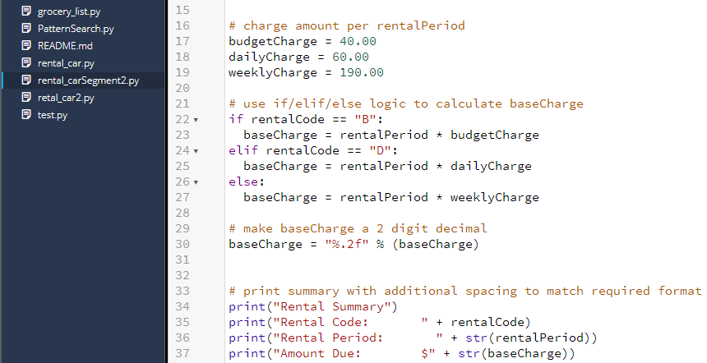

ALGORITHMS & DATA STRUCTURES (Original Code)

Slide 2
ALGORITHMS & DATA STRUCTURES (Enhancement)
CREATE valid selection list
GET rental period
GET starting odometer reading
GET ending odometer reading
CALCULATE total miles (ending odometer – starting odometer)
FOR rental type in list
IF rental type is budget
CALCULTE base charge (rental period * budget charge)
ELIF rental type is daily
CALCULTE base charge (rental period * daily charge)
ELSE
CALCULTE base charge (rental period * weekly charge)
FOR rental type in list
IF rental type is budget
CALCULATE mileage charge (total miles * 0.25)
ELIF rental type is daily
CALCULATE average daily mileage
IF average daily mileage is less than 101
SET extra mileage cost as 0
ELSE
CALCULATE extra mileage (average daily miles – 100)
CALCULTE extra mileage cost (extra miles * 0.25)
ELSE
CALCULATE average weekly mileage (total miles / rental period)
IF average weekly mileage is greater than 900
SET extra mileage charge to 100
ELSE
SET extra mileage charge to 0

Slide 3
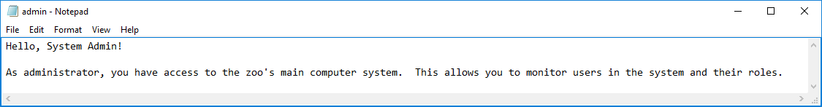
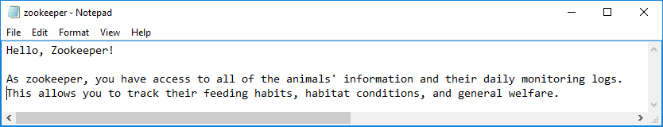
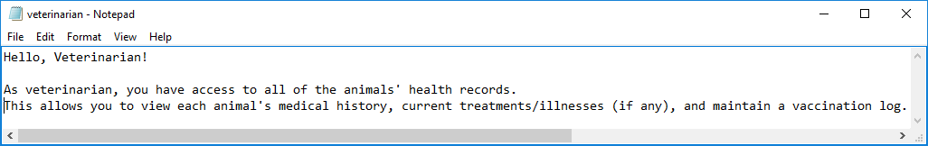
DATABASE (Original Code)

Slide 4
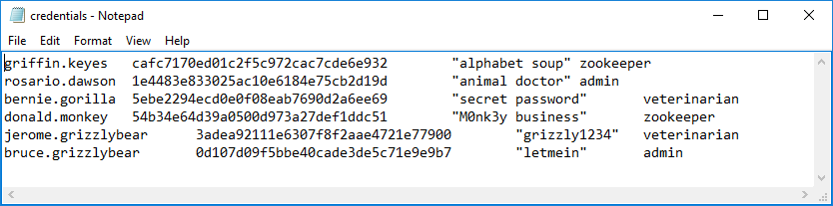
DATABASE (Original Code – continued)

Slide 5
DATABASE (Enhancement)
1 Database
3 Tables
Roles/Jobs Table
Employees/Credentials Table
Employees/Roles Table (relationally linked with foreign keys)
CREATE SQL database
CREATE database tables
POPULATE tables with IT-145 provided data (including such features as primary
keys and auto-increment)
UPDATE table content
DELETE table content
CREATE and demonstrate ability to write and use queries

